Slide 1
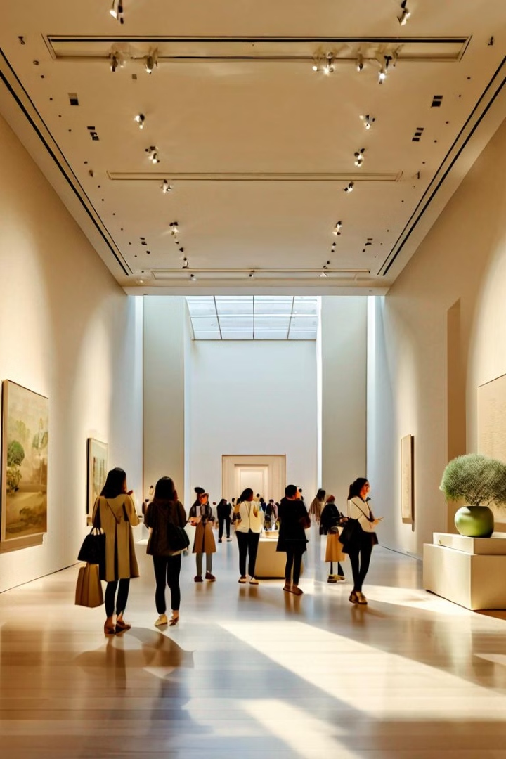
Multimodal Chatbot for the Metropolitan Museum of Art
By –
Abhishek
Prithviraj
Santanu
Satyam
Somnath

Slide 2
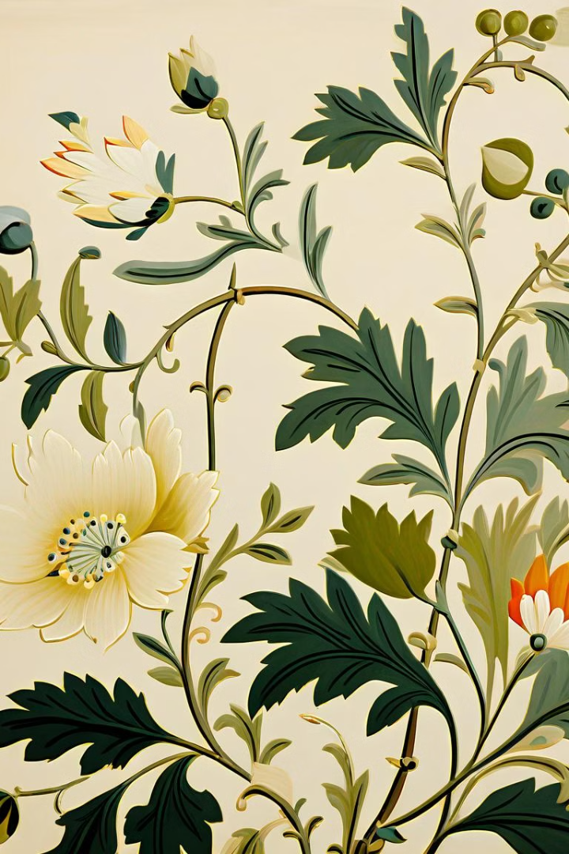
Project Overview
The goal of this project is to create a chatbot that can answer questions about images from the Metropolitan Museum of Art's collection. The dataset includes a wide range of art pieces and their associated metadata, enabling the chatbot to provide rich, contextual information to users in both English and Hindi.

Slide 3
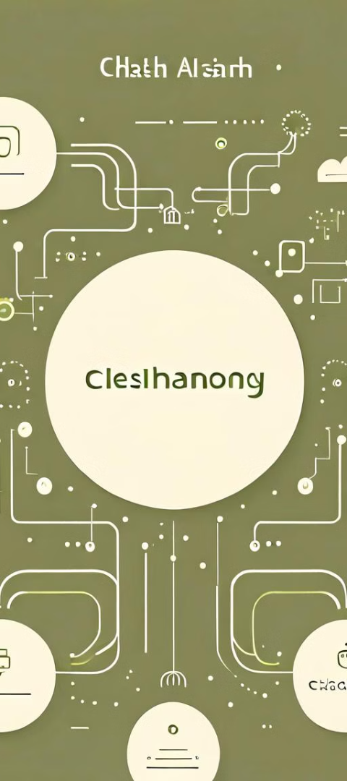
Methodology
1
Data Processing
The team loaded the JSON file containing the museum's image data, parsed the information, and used it to generate relevant questions and answers for the chatbot.
2
OpenAI API
The OpenAI API was leveraged to process the image data and create the question-answer pairs that form the core of the chatbot's knowledge base.
3
Language Translation
To ensure accessibility, the chatbot utilizes the Googletrans library to translate between English and Hindi, allowing users to interact in their preferred language.

Slide 4
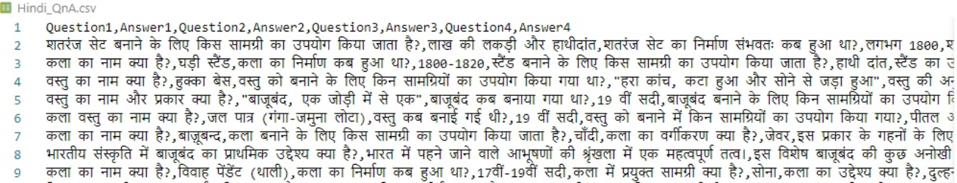
Results
Question-Answer Samples
Language Translation
The chatbot can generate insightful responses to a variety of questions about the art pieces, such as "What is the medium used in this painting?" or "Who is the artist behind this sculpture?"
The chatbot seamlessly translates between English and Hindi, allowing users to engage with the museum's collection in their preferred language.

Slide 5
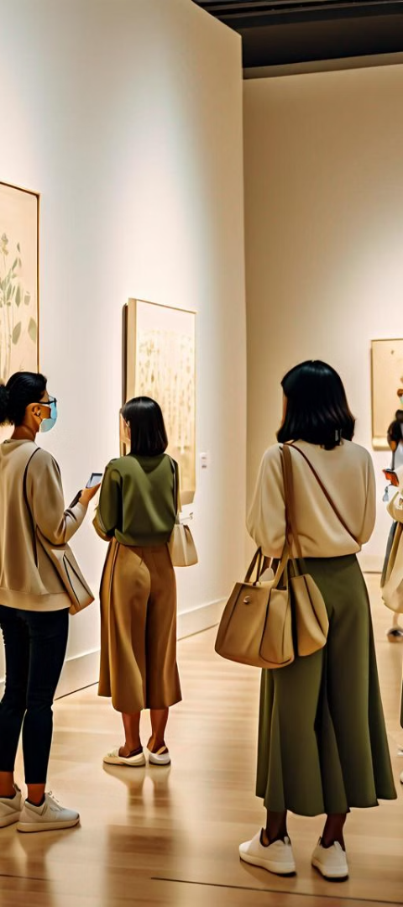
Conclusion and Future Work
1
Successful Implementation
2
Challenges Overcome
The multimodal chatbot has been well-received, providing visitors with a unique and engaging way to explore the museum's collection.
The team faced challenges in integrating the various technologies and ensuring seamless language translation, but they were able to address these issues and deliver a robust solution.
3
Future Improvements
Potential future improvements include expanding the language capabilities, enhancing the question-answer generation, and integrating with additional art datasets to provide an even richer user experience.

Slide 6
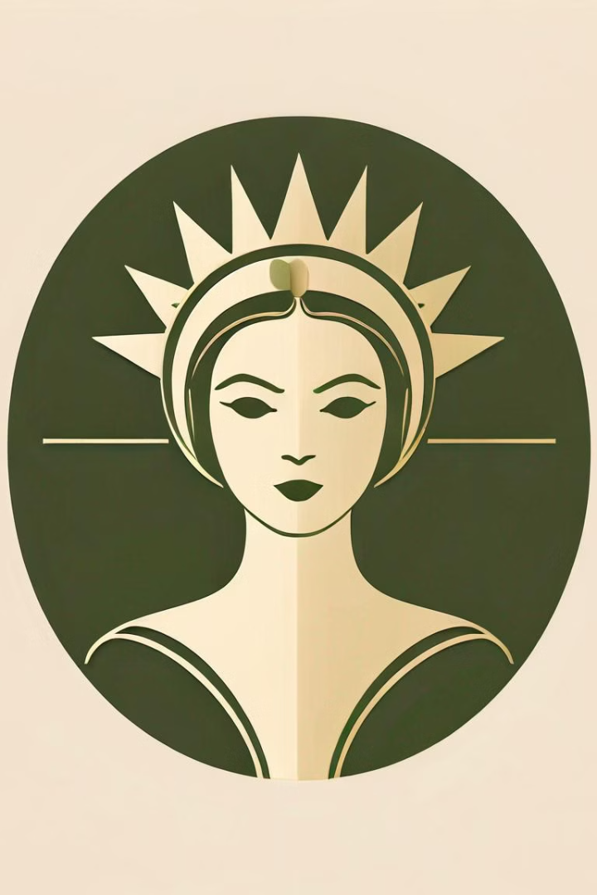
Acknowledgments
The team would like to express their gratitude to the Metropolitan Museum of Art for providing the dataset and supporting this innovative project. We also thank the OpenAI and Googletrans teams for their valuable contributions to the development of this multimodal chatbot.

